Slide 1
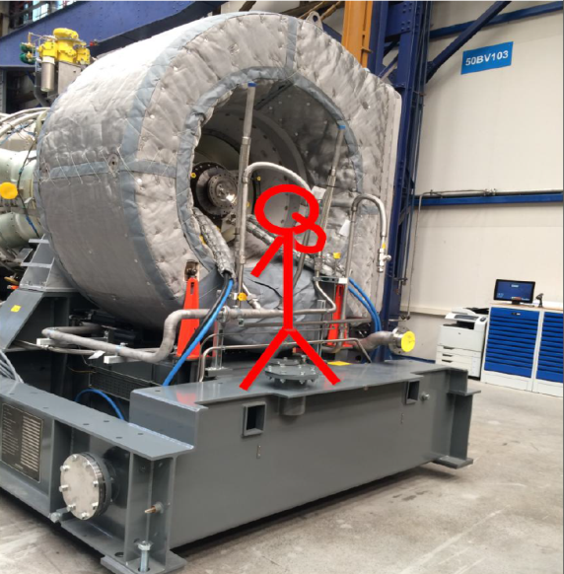
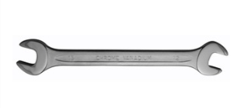
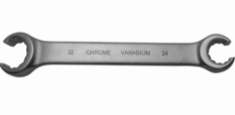
HS&E INCIDENT BULLETIN |  | 1st half year 2017
Hengelo, Netherlands | Type of incident (Rib Bruise – Fall From Height)
Summary:
An employee was carrying out assembly activities. He used a set of stairs to gain access to a baseplate (approximately 1 m. (3.3 ft.) above the floor). The wrench he was using slipped from his grasp, causing the employee to lose his balance and fall off the baseplate. The employee was taken to a doctor, who confirmed he had broken ribs and a torn back muscle.
Root Causes: | Actions Taken Thus Far: Next Steps
No scaffolding or platforms were used to prevent the fall. The use of an open-end wrench instead of a tube-wrench increased the chance of the wrench slipping. The tube-wrench that was needed for the job was not available in the correct size | A Safety Stand Down was held with all assembly employees to discuss the causes and the importance of the availability and the use of the right tools and equipment. Order and use the ‘right’ tools for the job. Preventive actions are added to an ongoing project to address working at height risks. Evaluate additional methods to prevent this type of fall.

